Slide 1
CU Interfaces & Connectivity Check
Jayeshkumar Patel

Slide 2
Introduction
This is an extra check performed by the market to check interfaces beyond DU’s
The Market developed an automation script to check the interface and escalate to NOC (we cant fix them)
RAN interfaces are divided between Control Plane (HO, Registration etc.) & User Plane (User Data):
RAN interfaces – CP
N2 – CUCP & AMF
F1C – CUCP & DU
E1 – CUCP & CUUP
RAN interfaces – UP
N3 – CUUP & UPF (voice and data)
F1U – CU & DU
E1 – CUUP & CUCP

Slide 3
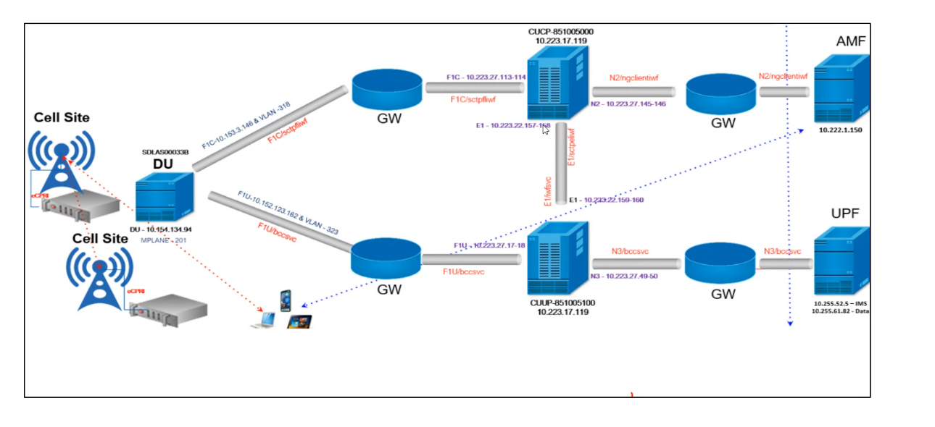
Interfaces are Checked twice a Day

Slide 4
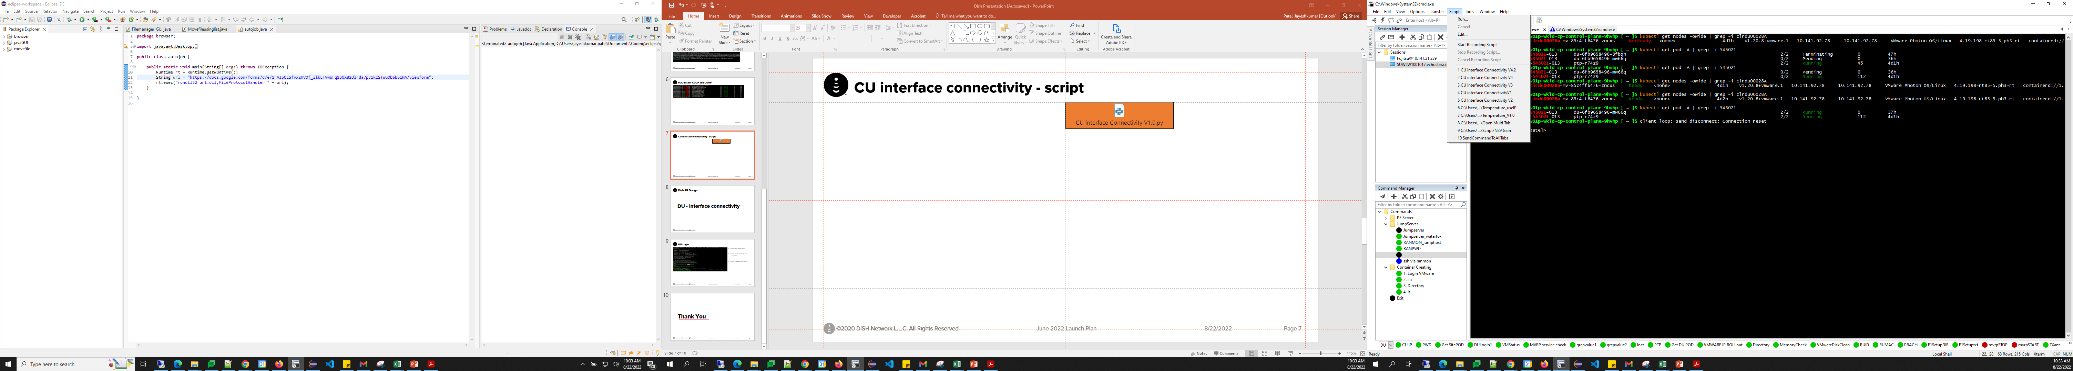
Steps to Run the Script
Required: AWS NDC and BEDC Access
1- Create CSV input files from the IP CIQ and Master DB
2- Login to NDC/BEDC in secureCRT
3- Click on Script tab and Run script
- Select csv file which you created with above info for you sites
Site ID | CIQ gNodeB ID | F1C | F1U | UPF(Data) | UPF(Voice) | BEDC Scripts
CLRDU00071A | 545043 | 10.141.166.224 | 10.141.134.224 | 10.255.12.218 | 10.255.59.5 | ./bedc_charlotte_CLT_RDU_04.sh

Slide 5
Output
Once script start running you will see Output file created in output folder under the folder where you selected CSV file.
You will see output file like this format
Issues Can be escalated to NOC spaces to be resolved before DT

